Slide 1

The Cornell NSF-Census Research Node: Integrated Research Support, Training and Data
William Block, Co-PI Warren Brown & Stefan Kramer, Senior Scientists Florio Arguillas & Jeremy Williams, Project Staff
Cornell Institute for Social and Economic Research (CISER)
3rd Annual European DDI Users Group Meeting (EDDI11), Dec. 6, 2011

Slide 2

Overview
Background on NCRN and the RDC Environment
The Problem
Proposed Solution
Early Work

Slide 3
NSF 10-621: NSF-Census Research Network (NCRN) Program Solicitation
“The NSF-Census Research Network will provide support for a set of research nodes, each of which will be staffed by a team of scientists conducting interdisciplinary research and educational activities on methodological questions of interest and significance to the broader research community and to the Federal Statistical System, particularly the U.S. Census Bureau. The activities will be expected to advance both fundamental and applied knowledge as well as further the training of current and future generations of researchers in research skills of relevance to the measurement of economic units, households, and persons.”
Total funding: $18,500,000
Expected Number of Awards: 8 - 12

Slide 4
NCRN Program Goals
Establish a set of complementary research programs that advance the development of innovative methods and models for the collection, analysis, and dissemination of data in the social, behavioral, and economic sciences.
Relate fundamental advances in methods development to the problems of the Federal Statistical System, particularly the U.S. Census Bureau.
Facilitate the collaborative activities of scientists from across multiple disciplines, including the social, behavioral, and economic sciences, the statistical sciences, and the computer sciences.
Foster the development of the next generation of researchers in research skills of relevance to the measurement of economic units, households, and persons.

Slide 5
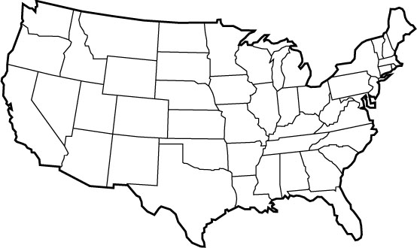










1
The RDC Network

Slide 6
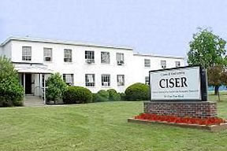
Research Opportunities at the Cornell Census Research Data Center (RDC)
CISER, 391 Pine Tree Road

Slide 7
Data Available in the RDC
Economic Data
Interview business establishments and firms
No public use versions
Demographic Data
Interview individuals and households
Complete geography, no income topcoding
Matched Employer-Employee Data
Health Data: Partnerships with
NCHS
AHRQ

Slide 8
Current situation within Census RDCs
Tension between confidentiality and user-friendliness
Lack of consistent documentation at variable level
Barriers to data discovery and use
Long term curation precluded
Scientific replication impossible
Two examples: Census of Manufactures and American Community Survey

Slide 9
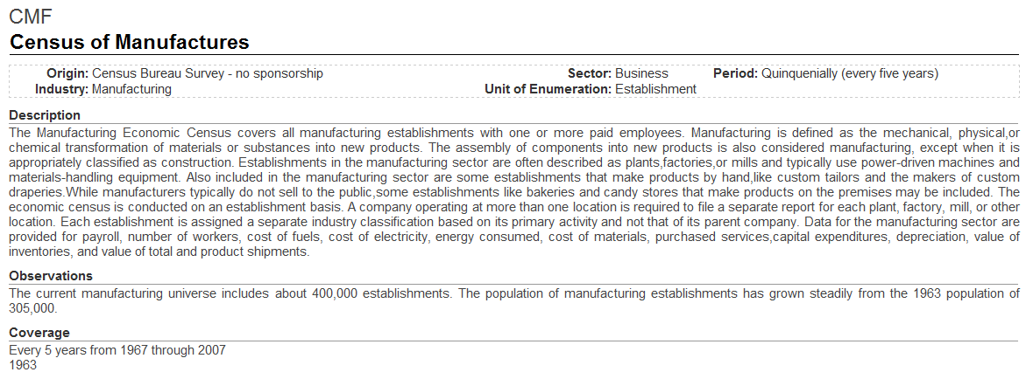
Present data documentation situation for RDC users
What can be learned online about the most widely used RDC dataset, the Census of Manufactures, outside of an RDC:
No information provided here about which variables are contained in this dataset.
Source: http://www.ces.census.gov/index.php/ces/researchdata?detail_key=3

Slide 10
Present data documentation situation for RDC users cont.
What can be learned online about the most widely used RDC dataset, the Census of Manufactures, inside an RDC. One can browse folders, “read me” files, or
Leave RDC, use a computer with public Internet access!

Slide 11
Example from American Community Survey (ACS)
Internal project experience
Data and basic SAS program file for ACS “zero obs” files
No internal documentation
IPUMS documentation (public)

Slide 12
The Cornell NSF-Census Research Node:
Integrated Research Support, Training, and Data
The Comprehensive Census Bureau Metadata Repository (CCBMR; co-PI Block)
DDI-based metadata schema
synchronization between public and confidential instances of the repository
Disclosure Avoidance Review-compliant and friendly
Similar web interfaces for public (partial) and internal (full-information) documentation
Create and share a CCBMR toolkit
Other elements of the Cornell NCRN Project
Integrated Doctoral Instruction on the Information Science of Restricted-access Data Analysis (PI: John Abowd; co-PI: Lars Vilhuber)
Adding Computational Statistics to the Administrative Record Toolkit (co- PI Ping Li)

Slide 13
Different metadata inside vs. outside RDCs
Not all of the metadata about studies in RDCs that should be viewable inside an RDC can be made available on the public web
Example: certain value ranges, or the very existence, of a variable cannot be made known outside of an RDC
Two different versions of a metadata: bad idea
Better: complete internal version; derive subset for public

Slide 14
How DDI could help with this challenge
Develop a metadata schema based on DDI, with modifications and additional fields/elements and/or attributes as warranted to capture and represent the necessary information about RDC datasets
Information about specific confidentiality considerations and access conditions can already be expressed in the DDI 3.1 specification with elements such as <ConfidentialityStatement> and <AccessConditions>
DDI could be extended through the addition of machine-actionable markup describing variables to control what information about them is revealed – example follows (assuming an XML-based implementation, which is not the only option)

Slide 15


How DDI could help with this challenge (cont.)
RDC Metadata (complete) <d:VariableSet> <d: VariableItem>…:<d:/VariableItem> <d:Disclosability> <d:min disclosable=’’yes’’>0</d:min> <d:max disclosable=’’no’’>345678</d:max> </d:Disclosability> </d:VariableSet> | Derived Public Use Metadata (limited) <d:VariableSet> <d: VariableItem>…:<d:/VariableItem> <d:Disclosability> <d:min>0</d:min> <d:max>not disclosable</d:max> </d:Disclosability> </d:VariableSet>
The above example denotes that one extreme value associated with this variable is not releasable, regardless of the public-use nature of other information on the variable. In this example, the maximum value would not be included in the publicly-released documentation.

Slide 16
Metadata platforms being considered for CCBMR
XML database:
BaseX or
eXist
or
Relational database (RDB):
SQL server (MS Windows only) or
PostgreSQL or
MySQL or
Oracle (or possibly others)
or
Hybrid approach of using RDB and storing XML (such as variable-level DDI generated by Stat/Transfer) as objects inside it
or
Proprietary product:
Colectia Repository with SDK (with which we could create a customized web front-end)
Related to this topic: Representing and Utilizing DDI in Relational Databases (http://dx.doi.org/10.3886/DDIOtherTopics02)

Slide 17
Metadata specifications being considered for CCBMR
DDI
SDMX
DataCite
Approach: “as much as necessary, as little as possible” metadata for the project; not limited only to DDI

Slide 18
From draft functional requirements for CCBMR of Nov. 14, 2011
….
3. Searching and navigating
3.1. Nested Boolean searching (i.e.: (A OR B) AND (X OR Y OR Z))
3.2. Explicit truncation
3.3. Case-sensitivity option
3.4. Date-range searching
3.5. Choice which field(s) to search, e.g., title, description/abstract, variable-level elements
3.6. Browsing by … to-be-determined fields/elements
3.7. Searching by values from summary statistics in metadata?
4. Metadata export and transformation
4.1. Between RDC-internal and external version, generate elements/fields and their contents based on the (to be) developed suppression method (page 6 of proposal – “Disclosability” example)
4.2. In a format that will allow fairly easy creation of syntax/command files for statistical packages – DDI?
5. Metadata import and transformation
5.1. Ingest DDI 3.x metadata generated by tools such as Stat/Transfer from datasets housed in RDC that are selected for project
5.2. Transform ingested metadata into schema (to be) developed for project, e.g., rename and/or drop fields/elements
5.3. Import metadata from/for PUFs, e.g. from IPUMS – method TBD
6. Metadata editing
6.1. Web-based front end for adding and editing metadata elements
7. Persistent identifiers
7.1. Use DOIs? Needs further consideration.

Slide 19
CCBMR: planned features
Nested Boolean searching, for instance: (Literacy OR Dropout rates) AND (Employee turnover OR Employee retention) AND (Number of employees)
Harnessing collective knowledge: incorporating social media (“data wikis”)

Slide 20
Initial CCBMR Datasets
Longitudinal Business Database (LBD)
American Community Survey (ACS)
American Housing Survey (AHS)
Longitudinal Employer-Household Dynamics (LEHD)

Slide 21
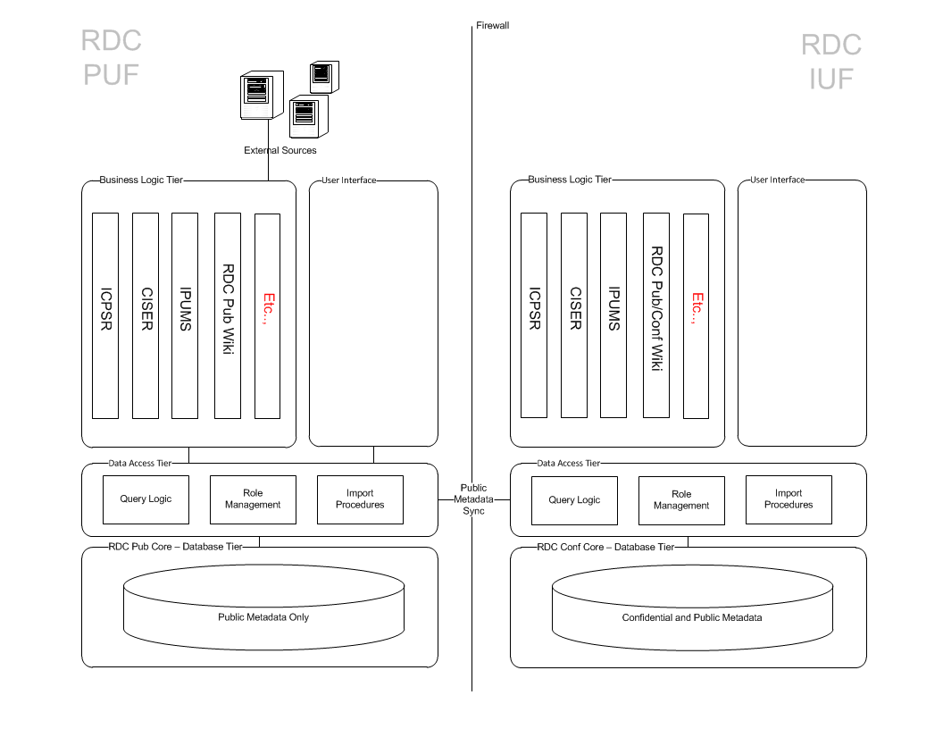
First draft of an enterprise application diagram

Slide 22





Project Collaborators
Pascal Heus – Metadata Technology
Jeremy Iverson – Colectica
Ingo Barkow – German Institute for Educational Research (DIPF)
David Schiller - Research Data Center (FDZ) of the German Federal Employment Agency (BA) at the Institute for Employment Research (IAB)
Chuck Humphrey – University of Alberta; Canadian RDC Network

Slide 23
Thank you!
Questions? Comments?
William Block
block@cornell.edu

